Slide 1

Arrays, Strings and Pointers
Dr. Murali Krishna Enduri
Department of CSE

Slide 2
C: Arrays
An Array is a collection of variables of the same type that are referred to through a common name.
Arrays offer a convenient means of grouping together several related variables, in one dimension or more dimensions:
Declaration
datatype var_name[size]
e.g
int A[6];
double d[15];

Slide 3
C: Array Initialization
After declaration, array contains some garbage value.
Static initialization
Run time initialization
int month_days[] = {31, 28, 31, 30, 31, 30, 31, 31, 30, 31, 30, 31};
int i;
int A[6];
for(i = 0; i < 6; i++) A[i] = 6 - i;

Slide 4
C: Array Accessing an element
int A[6];
6 elements of 4 bytes each, total size = 6 x 4 bytes = 24 bytes
Read an element
Write to an element
int i;
int A[6];
for(i = 0; i < 6; i++) A[i] = 6 - i;
A[0] | A[1] | A[2] | A[3] | A[4] | A[5]
0x1000 | 0x1004 | 0x1008 | 0x1012 | 0x1016 | 0x1020
6 | 5 | 4 | 3 | 2 | 1
int tmp = A[2];
A[3] = 5;

Slide 5
C: Storing values given by the user in an array
Reading the input into an array is done as shown.
int a[10]; /* an array with 10 “int” elements */
int i;
for(i=0 ; i< 10; i++)
scanf(“%d”, &a[i]);
The idea is that first a value must be read and copied into a[0], then another value read and copied into a[1], and so on, until all the input values have been read.
The following code segment prints the elements of an array, a[10].
for(i=0 ; i< 10; i++)
printf(“%d”, a[i]);

Slide 6
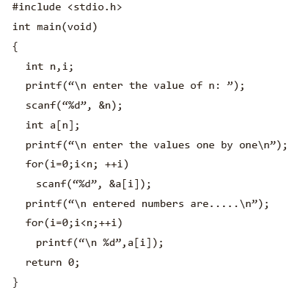

Slide 7
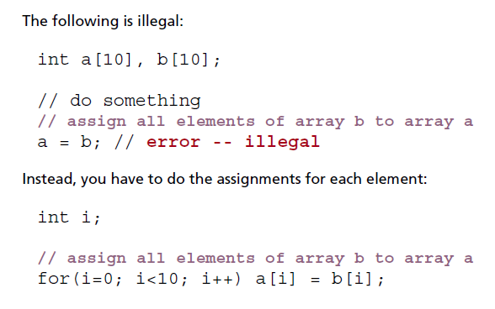
C: Copy one Array to Other

Slide 8
C: Other Allowed Operations on arrays
(a) To increment the ith element, the given statements can be used.
ar[i]++;
ar[i] += 1;
ar[i] = ar[i] + 1;
(b) To add n to the ith element, the following statements may be used,
ar[i] += n;
ar[i] = ar[i] + n;
(c) To copy the contents of the ith element to the kth element, the following statement may be written.
ar[k] = ar[i];
(d) To copy the contents of one array ‘ar’ to another array ‘br’, it must again be done one by one.
int ar[10],br[10];
for(i = 0; i < 10; i = i + 1)
br[i] = ar[i];
(e) To exchange the values in ar[i] and ar[k], a ‘temporary’ variable must be declared to hold one value, and it should be the same data type as the array elements being swapped.
int temp;
temp = ar[i];
/* save a copy of value in ar[i] */
ar[i] = ar[j];
/* copy value from ar[j] to ar[i] */
ar[j] = temp;
/* copy saved value of ar[i] to ar[j] */

Slide 9
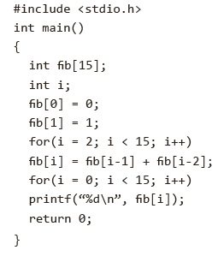


Slide 10
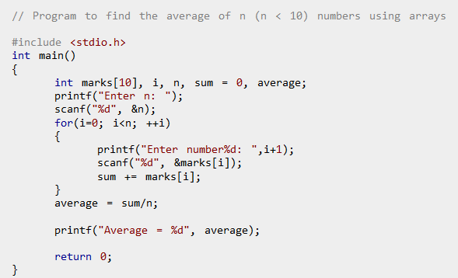

Slide 11
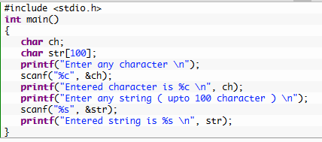
C: Strings
Strings can be declared like one-dimensional arrays.
For example, char str[30]; char text[80];
An array formed by characters is a string in C.
The end of the string is marked with a the null character.
#include <stdio.h>
int main()
{
char s[]=“Hello, World”;
printf(“%s\n”,s);
return 0;
}

Slide 12
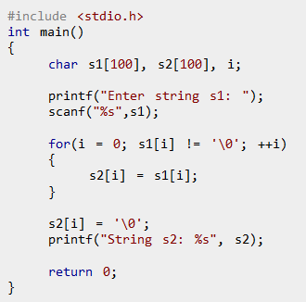
C: Copying a string into another
Since C never lets entire arrays to be assigned, the strcpy() function can be used to copy one string to another.
Copy String Manually Without Using strcpy()
#include<stdio.h>
#include <string.h>
int main()
{
char s1[] =“Hello, world!”;
char s2[20];
strcpy(s2, s1);
printf (“%s”,s2);
return 0;
}

Slide 13
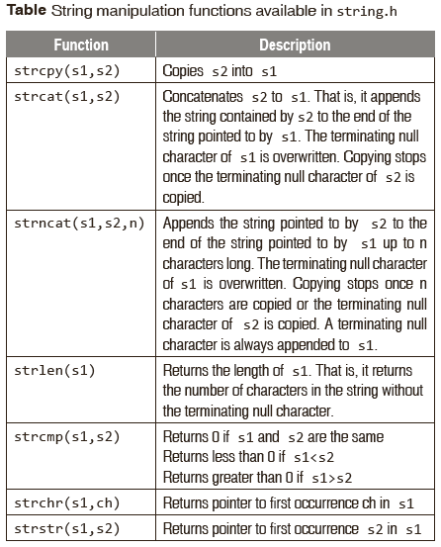

Slide 14
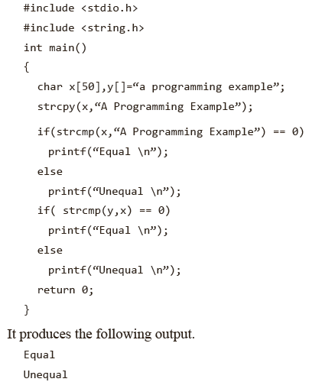
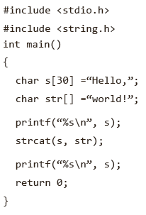

Slide 15
C: Practice problems
Write a C program to create a array of n numbers (user input from keyboard) where n is given as input from user.
Write a C program to sum all the numbers in an array.
Write a C program to multiply all the numbers in an array.
Write a C program to print the even numbers from a given array.
Write a C program that takes an array and returns a new array with unique elements of the first array.
Find the maximum element in an array.
Print the alternate elements from an array.
Write a C program to print a specified array after removing the 0th, 4th and 5th elements. Example: Input: 5,55,60,70,46,78,90, Output: 55,60,70,90
Write a C program to create an array of each digit is a element in a array from a number. Example: Input: 5467, Output: 5,4,6,7 (hint: while loop with % and //)
Write a C program to form a number from a given array of digits Example: Input: 5, 4, 6, 7, Output: 5467 (hint: for loop)
Write a C program to convert a list of characters into a string. Example: Input: ‘s’, ’t’, ’r’, ’i’, ’n’, ’g’, Output: string.

Slide 16
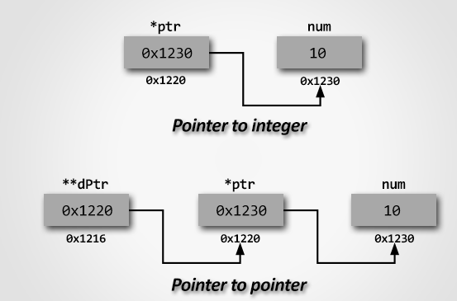
C: Pointers
A pointer is a reference to another variable (memory location) in a program
Used to change variables inside a function (reference parameters)
Used to remember a particular member of a group (such as an array)
Used in dynamic (on-the-fly) memory allocation (especially of arrays)
Used in building complex data structures (linked lists, stacks, queues, trees, etc.)

Slide 17
C: Pointers
A char pointer points to a single byte.
An int pointer points to first of the four bytes.
A pointer itself has an address where it is stored in the memory. Pointers are usually four bytes.
* is called the dereference operator
*p gives the value pointed by p
& (ampersand) is called the reference operator
&i returns the address of variable i
int *p; ⬄ int* p;
4
i
p
int i = 4;
p = &i;

Slide 18
Basic syntax: Type *Name
Examples:
int *P; /* P is var that can point to an int var */
float *Q; /* Q is a float pointer */
char *R; /* R is a char pointer */
Complex example:
int *AP[5]; /* AP is an array of 5 pointers to ints */
int x = 1, y = 2, z[10];
int *ip; /* A pointer to an int */
ip = &x; /* Address of x */
y = *ip; /* Content of ip */
*ip = 0; /* Clear where ip points */
ip = &z[0]; /* Address of first element of z */

Slide 19
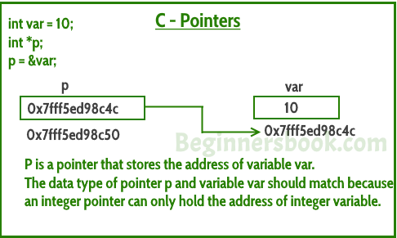
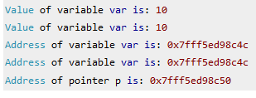
#include <stdio.h>
int main()
{
int *p;
int var = 10;
p= &var;
printf("Value of variable var is: %d", var);
printf("\nValue of variable var is: %d", *p);
printf("\nAddress of variable var is: %p", &var);
printf("\nAddress of variable var is: %p", p);
printf("\nAddress of pointer p is: %p", &p);
return 0;
}

Slide 20
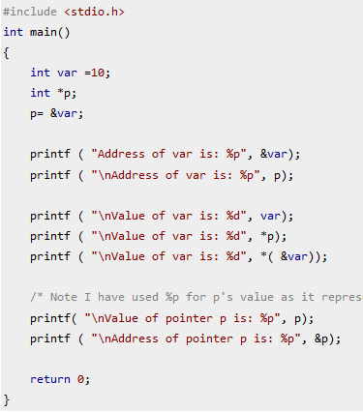
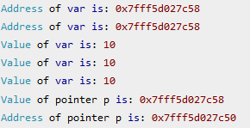
Output:

Slide 21
int *p, x = 20;
p = &x;
printf("p = %p\n", p);
printf("p+1 = %p\n", (int*)p+1);
printf("p+1 = %p\n", (char*)p+1);
printf("p+1 = %p\n", (float*)p+1);
printf("p+1 = %p\n", (double*)p+1);
Sample output:
p = 0022FF70
p+1 = 0022FF74
p+1 = 0022FF71
p+1 = 0022FF74
p+1 = 0022FF78
{program: pointer_arithmetic.c}

Slide 22
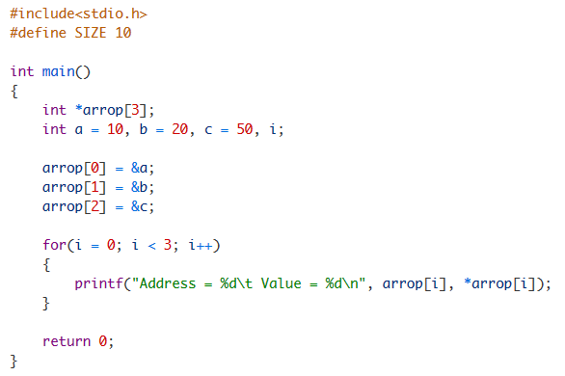


Slide 23
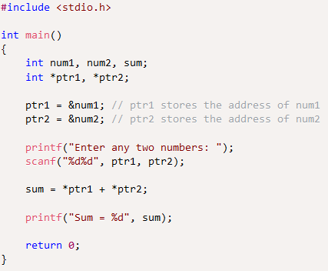
Program to add two numbers using pointers

Slide 24
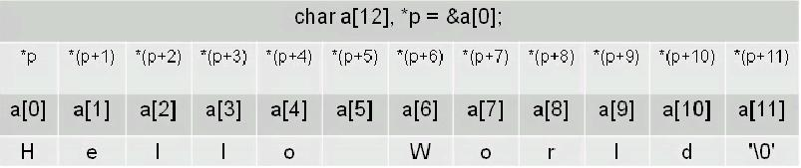
C: Pointers and Arrays
Pointers and arrays are tightly coupled.
char a[] = “Hello World”;
char *p = &a[0];

Slide 25
C: Pointers and Arrays
int A[5]
A is the address where the array starts (first element), it is equivalent to &(A[0])
A is in some sense a pointer to an integer variable
To determine the address of A[x] use formula:
(address of A + x * bytes to represent int)
(address of array + element num * bytes for element size)
The + operator when applied to a pointer value uses the formula above:
A + x is equivalent to &(A[x])
*(A + x) is equivalent to A[x]

Slide 26
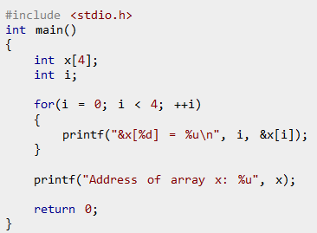
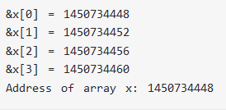
C: Pointers and Arrays with example

Slide 27
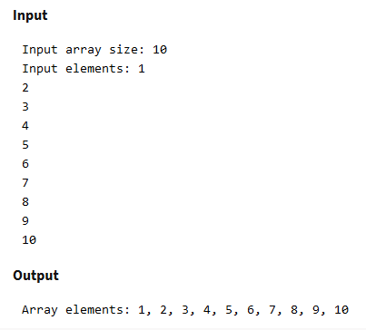
Program to input and print array elements using pointer
#include <stdio.h>
#define MAX_SIZE 100
void main()
{
int arr[MAX_SIZE], N, i;
int * ptr = arr; // Pointer to arr[0]
printf("Enter size of array: ");
scanf("%d", &N);
printf("Enter elements in array:\n");
for (i = 0; i < N; i++)
{
scanf("%d", ptr);
ptr++;
}
ptr = arr;
printf("Array elements: ");
for (i = 0; i < N; i++)
{
printf("%d, ", *ptr);
ptr++;
} }

Slide 28
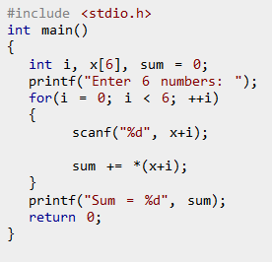
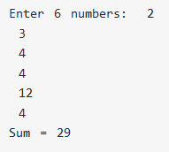

Slide 29
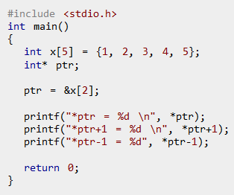


Slide 30
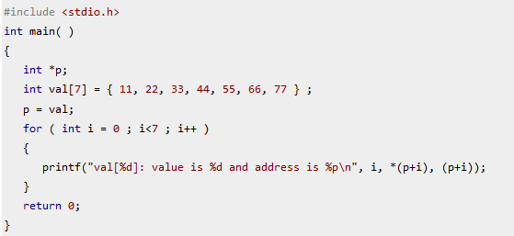
Output??

Slide 31
C: Practice problems
Write a C program to create, initialize and use pointers.
Write a C program to add two numbers using pointers.
Write a C program to swap two numbers using pointers.
Write a C program to input and print array elements using pointer.
Write a C program to copy one array to another using pointers.
Write a C program to swap two arrays using pointers.
Write a C program to reverse an array using pointers.
Write a C program to search an element in array using pointers.
Write a C program to find maximum element in array using pointers.
Write a C program to find length of string using pointers.
Write a C program to copy one string to another using pointers.
Write a C program to concatenate two strings using pointers.
Write a C program to compare two strings using pointers.
Write a C program to find reverse of a string using pointers.

Slide 32
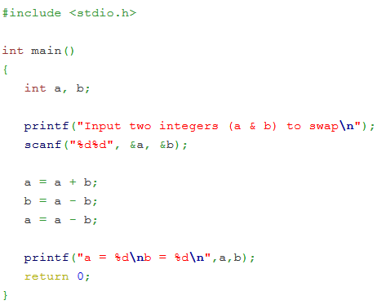
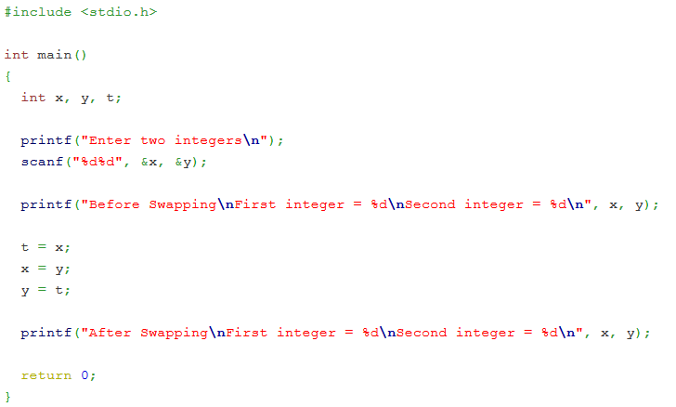
Write a C program to swap two numbers

Slide 33
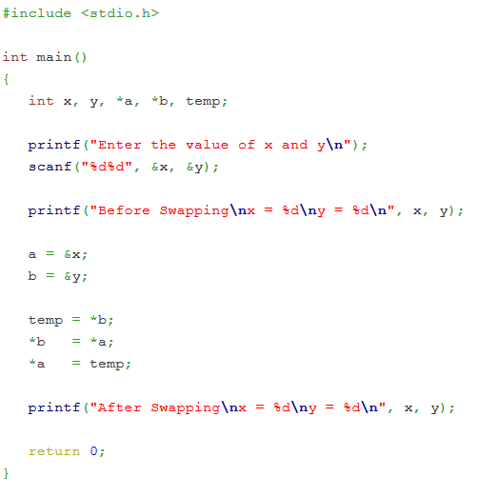
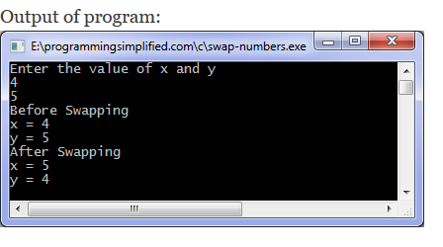
Write a C program to swap two numbers using pointers

Slide 34
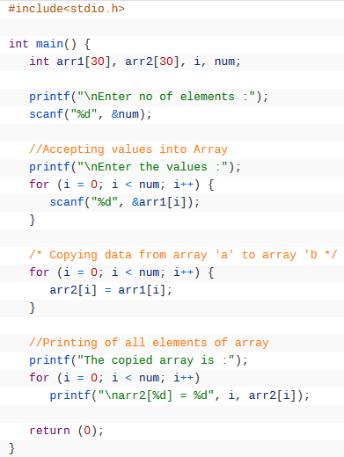
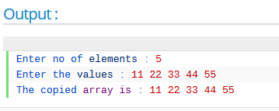
Write a C program to copy one array to another array with out using pointers

Slide 35
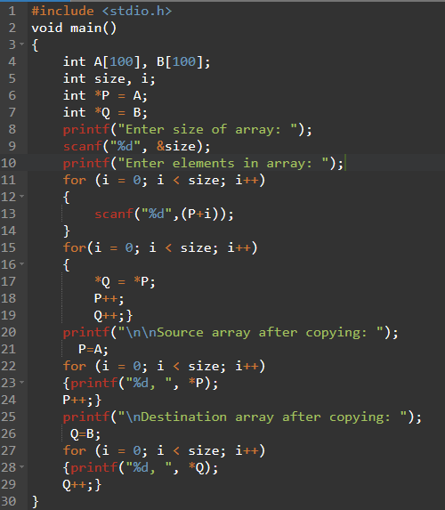
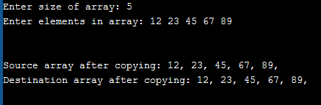
Write a C program to copy one array to another array with using pointers

Slide 36
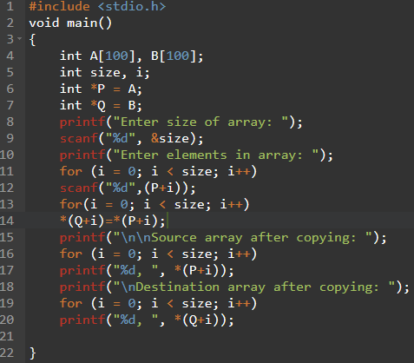
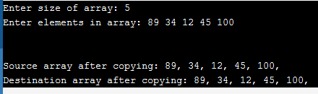
Write a C program to copy one array to another array with using pointers

